Slide 1
New EWP Process
By: Aliaksandr Li
Dan Ofer
Henry Woodhouse
Kyle Yee
DPT-1623

Slide 2
The OG Development Cycle
Problems with reversions (reverts)
Complicated and stupidly complex
Too many branches
Too many Pull Requests

Slide 3
The New EWP Process
Name inspired by the New Super Mario Bros. games
No more reversions in the develop branch
Developers manually push to the QA environment
Simplified release process to UAT and PPE environments
Environmentally friendly!

Slide 4
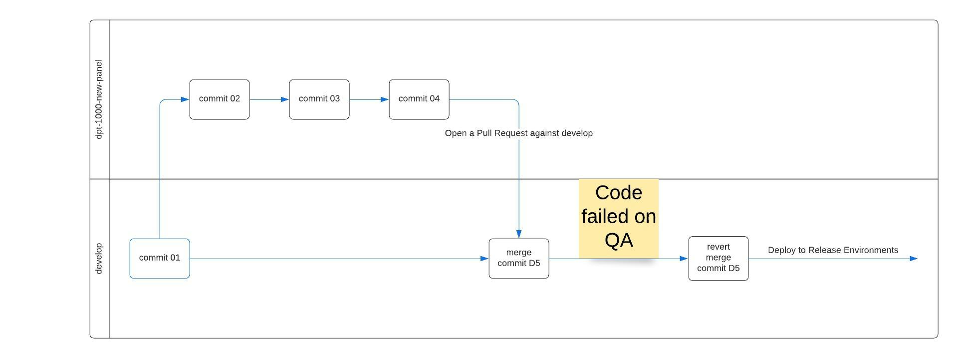
OG Development Process

Slide 5
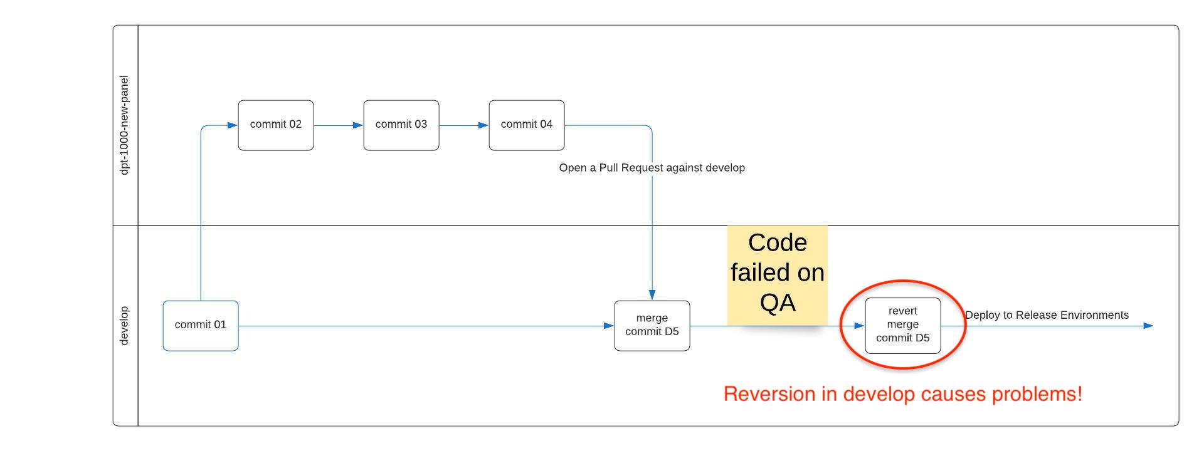
OG Development Process (with notes)

Slide 6
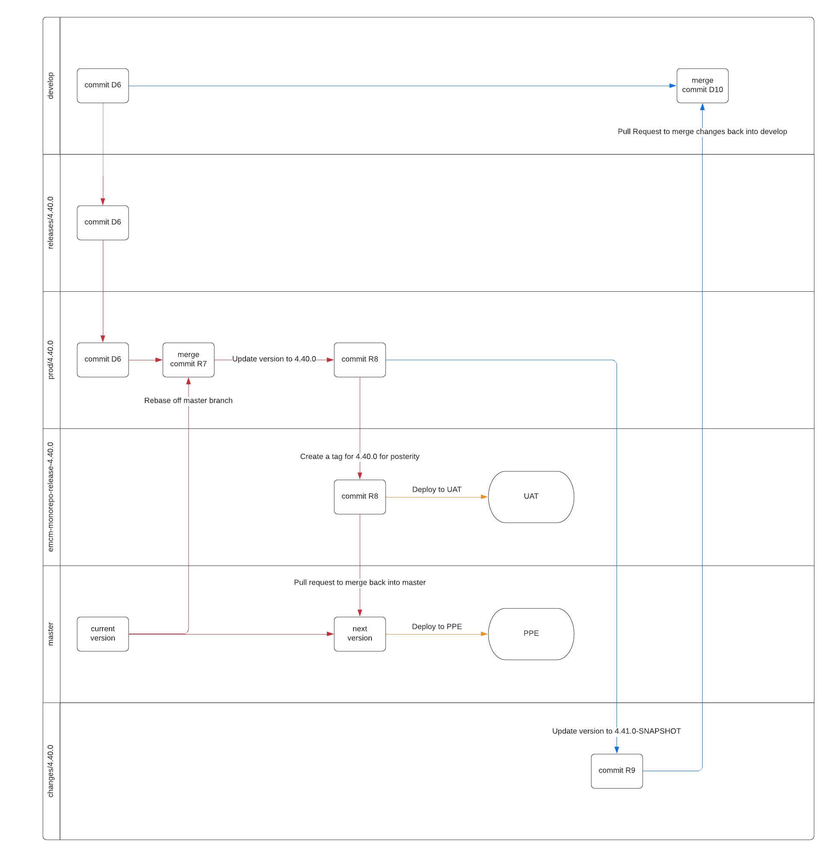
OG Release Process
Too complex!

Slide 7
Unnecessary branch!

Slide 8
Too many PRs

Slide 9
New simplified development process
Manually merge code into QA for testing
Only approved code is merged into develop

Slide 10
New development process
Developer pushes feature-branch into code repository, which automatically creates a Pull Request.
Developer needs two developers to approve the reviewed code.
Developer manually pushes code into QA,
git checkout qa;
git merge --no-ff <feature-branch>;
git push;
QA Engineer verifies the code.
Pull Request is approved by QA Engineer and merged into develop branch.

Slide 11
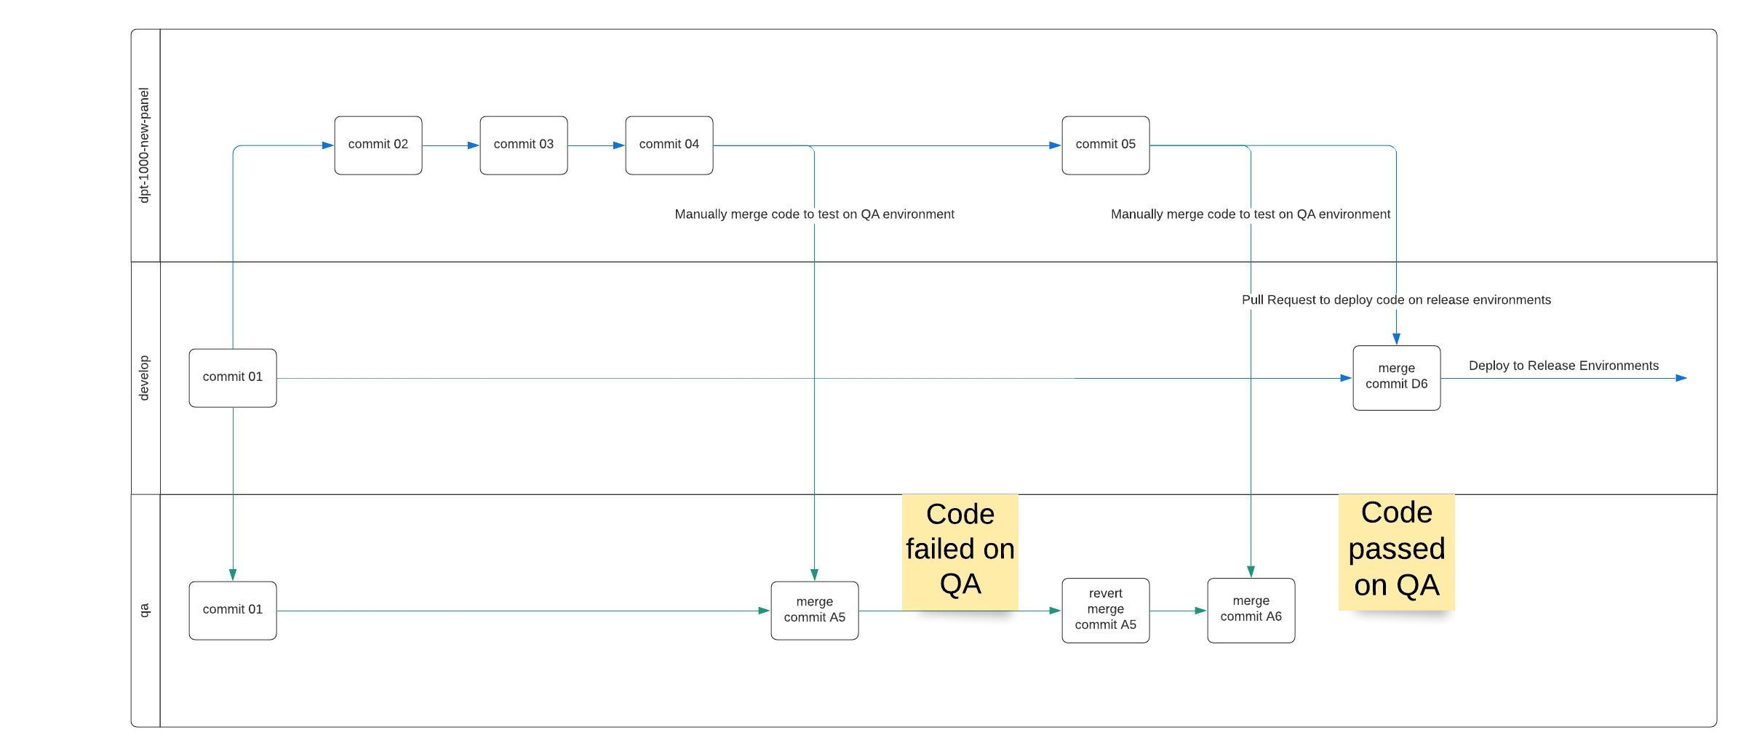
If QA passed
Merge the code!

Slide 12
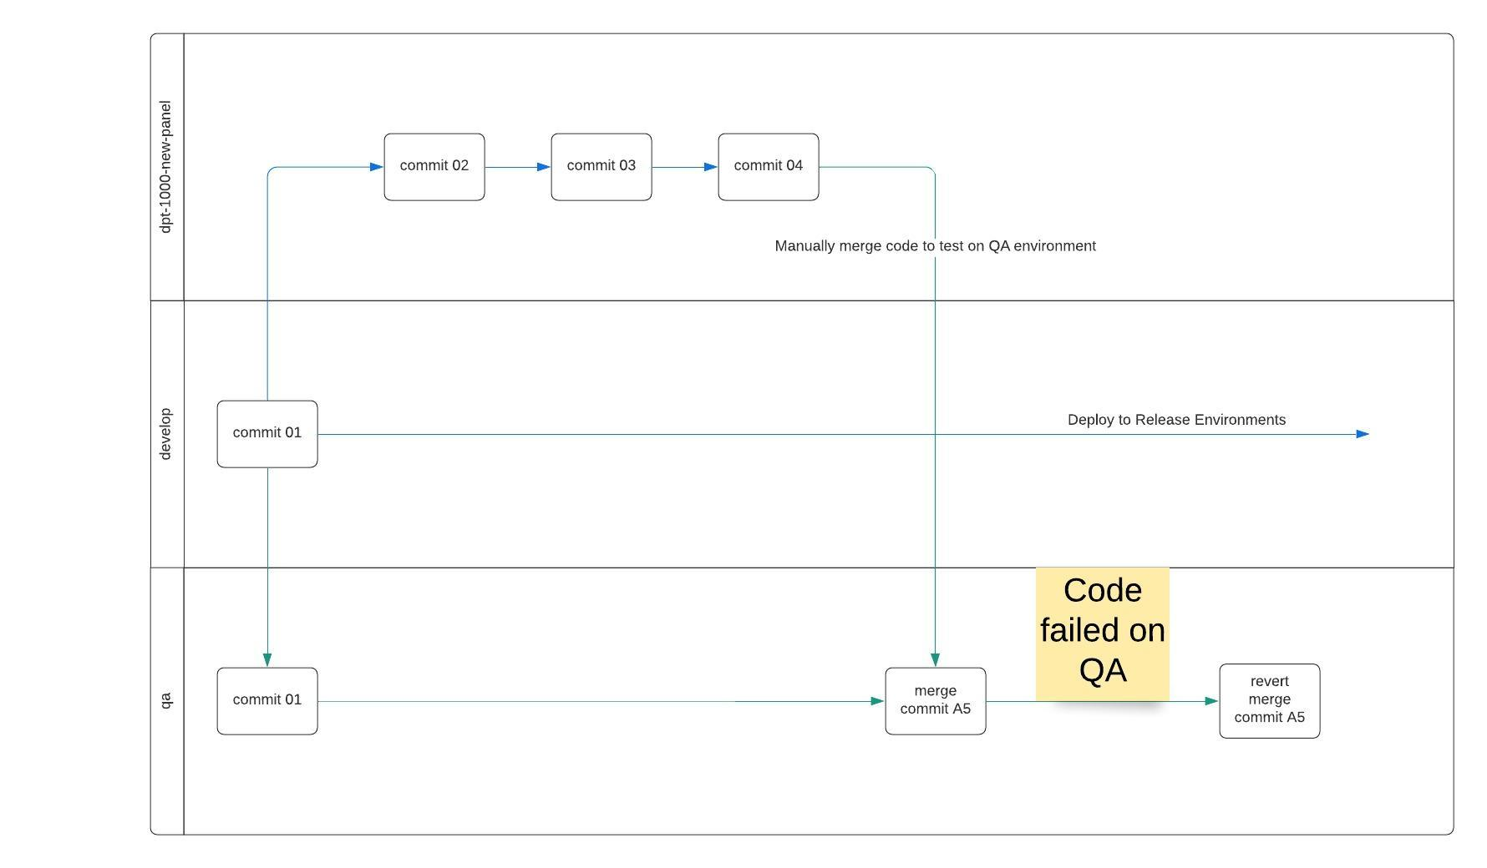
If QA failed
Do not merge failed code!

Slide 13
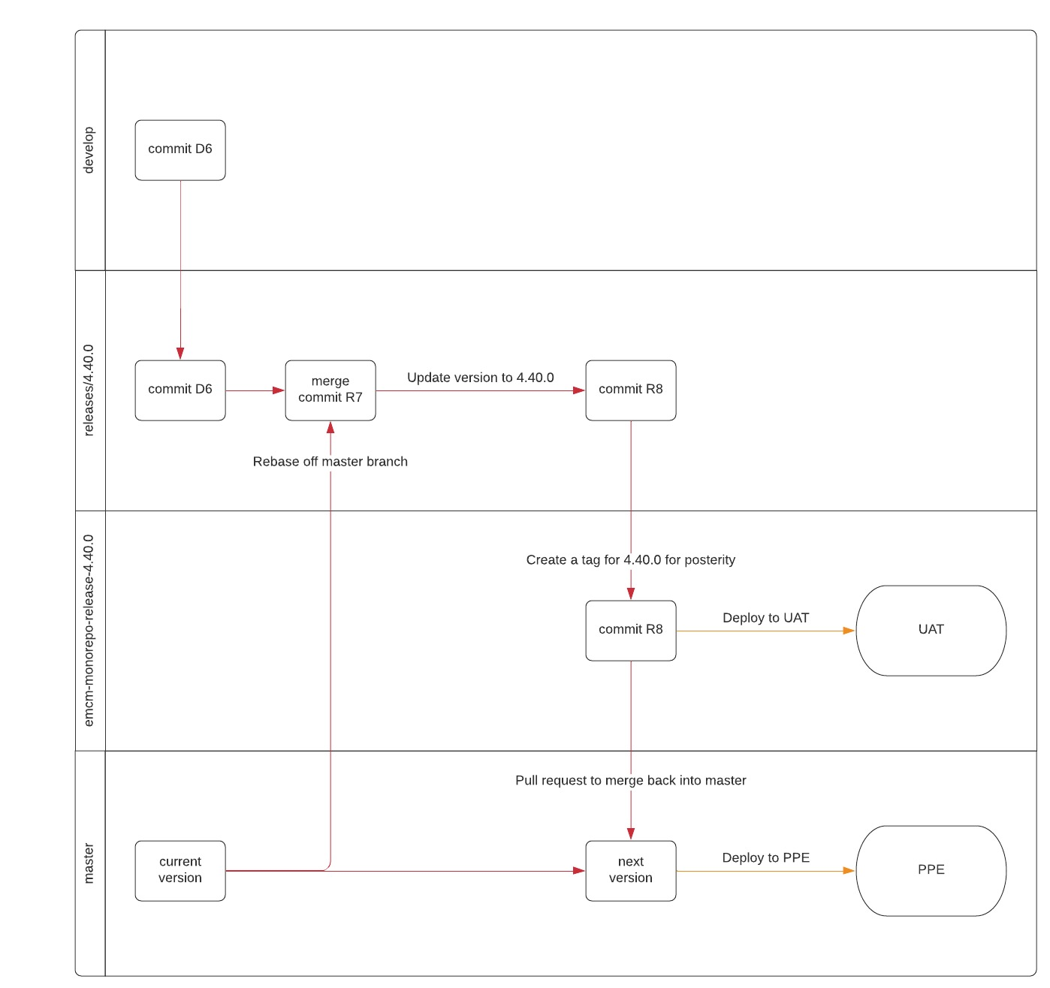
New simplified release process

Slide 14
Read more
https://confluence.thomsonreuters.com/display/DCE/Development+Process
https://confluence.thomsonreuters.com/display/DCE/Release+Process
https://confluence.thomsonreuters.com/display/DCE/Hotfix+Release+Process

